Slide 1

PERFORMANCE ENHANCEMENT TOOL TO OPTIMIZE SYSTEM RESOURCES IN WINDOWS OS
Raj Kumar M – 2021503039
Siva Jegadeesh C B – 2021503559
Babith Sarish S – 2021503009
Sharvesh S P - 2021503717
TEAM
13

Slide 2
OBJECTIVES
To remove windows bloatware
To reduce CPU And RAM usage
To clean tasks and auto startups
To deactivate windows indexing
To perform mouse acceleration and GPU flickering fix
To deactivate unnecessary windows components
To design a GUI for enabling or disabling function

Slide 3
LITERACY SURVEY
PAPER NO | PAPER | YEAR | AUTHORS | WORKS | DRAWBACKS
1. | "WinCuts: Automated Debloating of Windows Operating Systems" | 2016 | Imtiaz Karim, Yan Shoshitaishvili, Adam Doupé, Gail-Joon Ahn | This paper presents WinCuts, an automated debloating tool for Windows operating systems. WinCuts uses static analysis to identify and remove unused components, services, and features from the Windows OS. | The tool may not be effective in identifying all unused components and features, especially in cases where they are conditionally executed. Additionally, the tool may introduce compatibility issues or break system dependencies if critical components are removed.
2. | "Automated Windows Deobfuscation and Debloating" | 2019 | Noah Johnson, Eric Gustafson, Robert Walls, Mark McLean, William Enck | This paper presents an automated debloating and deobfuscation tool for Windows operating systems. The tool uses static analysis to identify and remove unused code, as well as deobfuscate obfuscated code. The tool was evaluated on several malware samples and showed that it can effectively debloat and deobfuscate malicious Windows binaries. | The tool may not be effective in identifying all unused code, especially in cases where code is conditionally executed. Additionally, the tool may introduce new vulnerabilities or bugs in the binary code due to the structural changes.

Slide 4
PAPER NO | PAPER | YEAR | AUTHORS | WORKS | DRAWBACKS
3. | "Safe and Automated Debloating of Windows Binaries" | 2020 | Rezwana Karim Toma, Hafiz Md. Hasan Babu, M. Abdullah-Al- Wadud, Reaz Ahmed | This paper presents a safe and automated debloating tool for Windows binaries. The tool uses a combination of static and dynamic analysis to identify and remove unused code from the binaries while preserving their functionality. The tool was evaluated on several Windows binaries and showed that it can significantly reduce their code size and execution time. | The tool may not be effective in identifying all unused code, especially in cases where code is conditionally executed. Additionally, the tool may introduce new vulnerabilities or bugs in the binary code due to the structural changes. The overhead of the dynamic analysis may also affect the performance of the system.
4. | "Debloating Windows with Code Pointer Separation" | 2018 | Kun Sun, Xiaoguang Zhang, Dongdong She, Wei Zou | This paper proposes a technique for debloating Windows by separating code pointers from data pointers. The technique uses hardware support for memory protection to prevent execution of data pointers as code. The authors evaluated the technique on several Windows applications and showed that it can significantly reduce code size and improve security. | The technique requires hardware support for memory protection, which may not be available on all systems. Additionally, the technique may introduce performance overhead due to the additional checks on memory access.

Slide 5
KEY WORDS
Disk Cleanup
Disk Defragmenter
Registry Cleaner
System File Checker
Uninstall bloatware
Disable Visual effects
Schedule regular maintenance

Slide 6
PROBLEM STATEMENT
Windows 10 is becoming increasingly debloated over time, resulting in poor performance, frequent crashes, and slow-loading applications.
SOLUTION:
Develop a tool that can identify and remove unnecessary files and programs from windows 10, and optimize the system for maximum performance.

Slide 7

PROPOSED ARCHITECTURE

Slide 8
Original source
code
Analyse the bloat
Code reduce
Internet
Vulnerability analysis
CVE mapped source code
Code isolation
Detecting junks
Storage
manager
analysis
Debloat
Security check
Integrity check
Debloated
source
code
Test case
Performance
validate

Slide 9
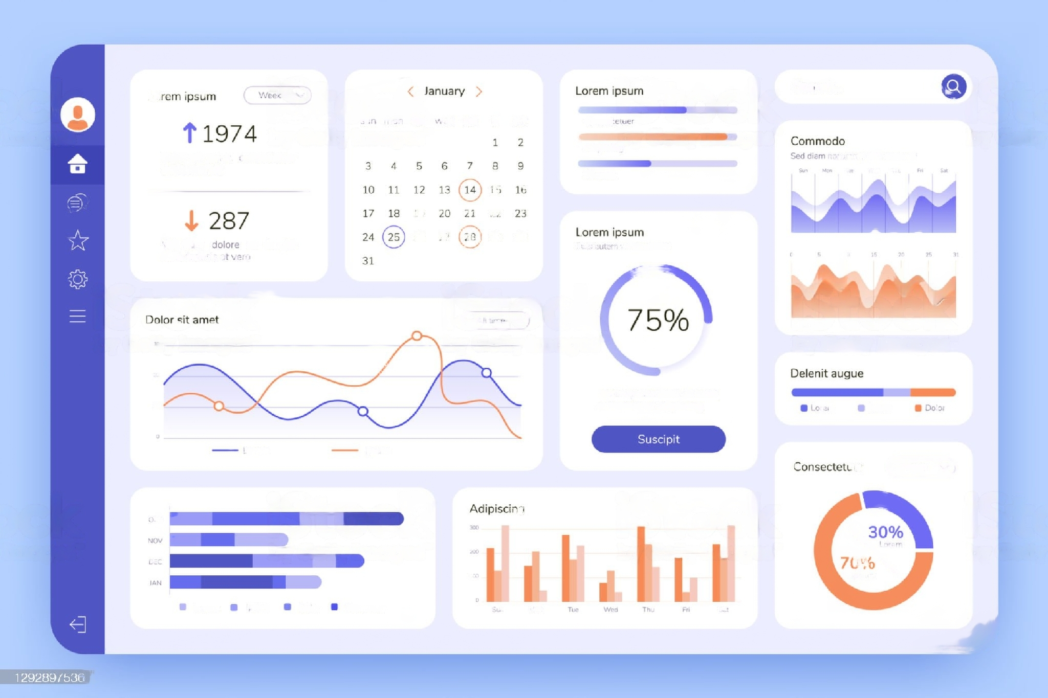
GRAPHICAL USER-INTERFACE
A GUI has been introduced for the users to interact with the software more efficiently
It provides an overall view of the performance of the software
It consists of several options which can be accessed by the users based on their needs

Slide 10

RUN DISK CLEANUP
Disk cleanup helps free up space on your hard disk, creating improved system performance.
It helps to delete temporary files, internet cache files and unnecessary program files safely
Enables us to clean the disk directly

Slide 11
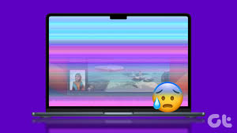
GPU FLICKERING FIX
Improper functioning of the graphics card causes display flickering which can be resolved by this software
Detects the problem by checking whether the software works properly by interacting with the hardware equipped with it
The problem can also be resolved via graphics card controller

Slide 12
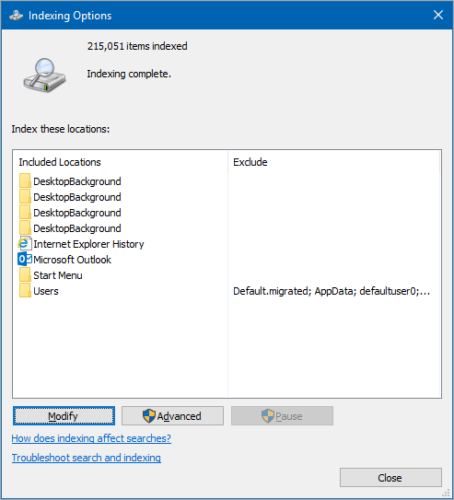
DEACTIVATING WINDOWS INDEXING
The windows search indexer is only required if we search only our directories and files
If we don’t use this to locate specific files or media we can definitely disable it
Disabling this feature brings significant improvement in the performance of the computer

Slide 13


OPTIMIZED USAGE OF RAM
Unnecessary usage of RAM by the junk files can be stopped through debloating technique
RAM becomes more efficient to handle other necessary tasks
Sorting this junk files can be easily achieved through this software

Slide 14

PROPOSED ALGORITHM

Slide 15
Start
Uninstalling the optional features using the pop up dialog box
Changing the feedback frequency to never
Blocking sign-in info to automatically finish the setting up device and reopen apps after an update or restarting it
Getting the necessary system files
Mapping bloatware's in the files
Separating bloat files from the system package
Removing bloat files
Generating new files without bloats
Processing those files when needed

Slide 16
Repeat the process until the software recognizes files without bloatware’s
This software should perform these tasks in the bg whenever a new package is loaded in the RAM or downloaded
Optimized disk usage is achieved
RAM is utilized much efficiently without any bloatware's which improves the performance
GUI consists of several buttons that are attached to the windows PowerShell script for individual bloatware removal and removal of all bloatware’s in the pc
PowerShell language is used to interact with the kernel of the operating system to perform all these tasks
Stop

Slide 17
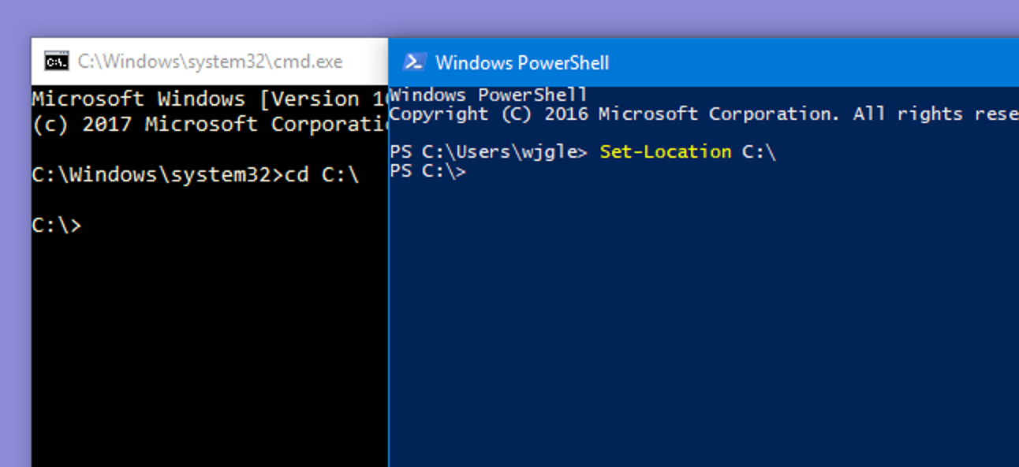

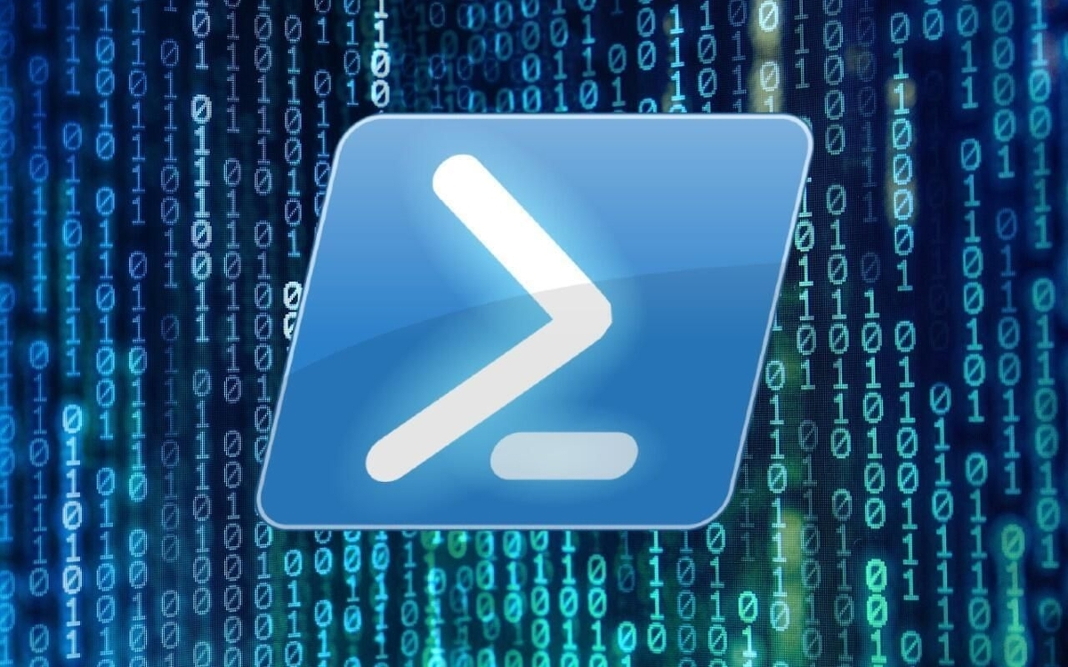
TOOL TO BE USED
POWERSHELL

Slide 18
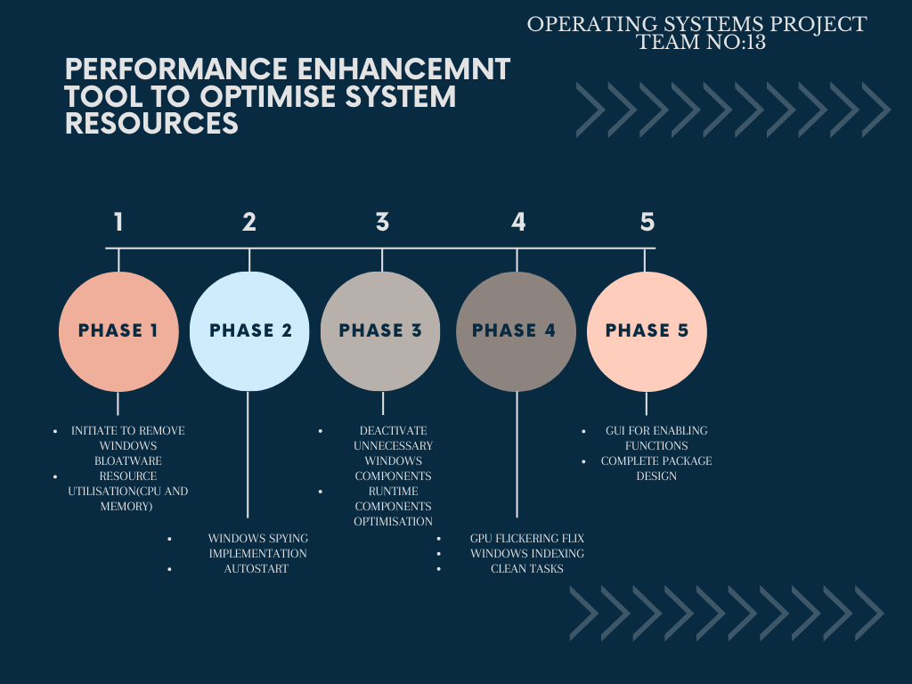
TIMELINE

Slide 19

REFERENCES
Y. Tang et al., "XDebloat: Towards Automated Feature-Oriented App Debloating," in IEEE Transactions on Software Engineering, vol. 48, no. 11, pp. 4501-4520, 1 Nov. 2022, doi: 10.1109/TSE.2021.3120213.
H. Sharif, M. Abubakar, A. Gehani and F. Zaffar, "Trimmer: Application Specialization for Code Debloating," 2018 33rd IEEE/ACM International Conference on Automated Software Engineering (ASE), Montpellier, France, 2018, pp. 329-339, doi: 10.1145/32381
D. He, J. Lu and J. Xue, "Context Debloating for Object-Sensitive Pointer Analysis," 2021 36th IEEE/ACM International Conference on Automated Software Engineering (ASE), Melbourne, Australia, 2021, pp. 79-91, doi: 10.1109/ASE51524.2021.9678880.
Ahmad et al., "Trimmer: An Automated System for Configuration-Based Software Debloating," in IEEE Transactions on Software Engineering, vol. 48, no. 9, pp. 3485-3505, 1 Sept. 2022, doi: 10.1109/TSE.2021.3095716.

Slide 20

REFERENCES
S. E. Ponta, W. Fischer, H. Plate and A. Sabetta, "The Used, the Bloated, and the Vulnerable: Reducing the Attack Surface of an Industrial Application," 2021 IEEE International Conference on Software Maintenance and Evolution (ICSME), Luxembourg, 2021, pp. 555-558, doi: 10.1109/ICSME52107.2021.00056
J. Wang, A. Li, H. Li, C. Lu and N. Zhang, "RT-TEE: Real-time System Availability for Cyber-physical Systems using ARM TrustZone," 2022 IEEE Symposium on Security and Privacy (SP), San Francisco, CA, USA, 2022, pp. 352-369, doi: 10.1109/SP46214.2022.9833604.
Q. Xin, F. Behrang, M. Fazzini and A. Orso, "Identifying Features of Android Apps from Execution Traces," 2019 IEEE/ACM 6th International Conference on Mobile Software Engineering and Systems (MOBILESoft), Montreal, QC, Canada, 2019, pp. 35-39, doi: 10.1109/MOBILESoft.2019.00015.
J. Lowdermilk and S. Sethumadhavan, "Towards Zero Trust: An Experience Report," 2021 IEEE Secure Development Conference (SecDev), Atlanta, GA, USA, 2021, pp. 79-85, doi: 10.1109/SecDev51306.2021.00027.

Slide 21
REFERENCES
A. Pilgun, "Don't Trust Me, Test Me: 100% Code Coverage for a 3rd-party Android App," 2020 27th Asia-Pacific Software Engineering Conference (APSEC), Singapore, Singapore, 2020, pp. 375-384, doi: 10.1109/APSEC51365.2020.00046.
Z. Hu and B. Dolan- Gavitt, "IRQDebloat: Reducing Driver Attack Surface in Embedded Devices," 2022 IEEE Symposium on Security and Privacy (SP), San Francisco, CA, USA, 2022, pp. 1608-1622, doi: 10.1109/SP46214.2022.9833695.

Slide 22
Thank you

